Slide 1
PROJECT BLIND EYE
9-17
TAN KWANG YIK TREMAINE (Leader) [4P3]
KHNG ASHLEY [4P3]
Notes:
Tremaine: Good morning Judges, we are “Project Blind Eye”, and this project is made up of 2 members, Me and Ashley. The name was inspired by the purpose of this project, which is to create a third eye for the visually impaired.

Slide 2
Brief Introduction To Project Blind Eye
Notes:
Tremaine: To start, we will briefly introduce you to Project Blind Eye!

Slide 3
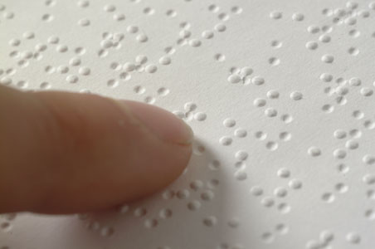
Problem Observed in Society
Blind people generally have lower literacy rates
High unemployment of blind adults
High dropout rates of blind high school students
Majority of physical books obviously cater to the visually blessed
Notes:
Tremaine: The main problems that blind people have faced are that they have lower literacy rates that generally turn to higher unemployment and dropout rates in high school. It is often argued that Braille can solve this problem, but majority of physical books with essential information are not published in Braille, hence highlighting the problem.

Slide 4

Objective
We aim to create a tool which aids blind people in reading contents on a paper out loud, be it text or images
Notes:
Tremaine: With this problem in mind, our project aims to implement a product to enable blind people to hear description of visual content on paper, including both text and images. This allows blind people to read books, thus solving the problem of low literacy rates.

Slide 5


Target Audience
We are targeting blind people above 12
Reason: Users below 12 might need the basic skills of using the product.
Notes:
Tremaine: This project targets blind people above 12 to ensure that they know how to use it.

Slide 6
Literature Review
Notes:
Ashley: Moving on to our literature review…

Slide 7
Literature Review
1) Literacy rates of legally blind people are very low
Less than 10% of people who are legally blind in the US are Braille Readers (“The Braille Literacy Crisis in America”, 2009)
Only 10% of blind children are learning Braille (“The Braille Literacy Crisis in America”, 2009)
Our project is important as society does not accept this severe illiteracy rate
Notes:
Ashley: …We found out that literacy rates of legally blind people are extremely low. According to the Braille Literacy Crisis Online Research Paper, less than 10% of legally blind people in the US are Braille Readers, and only 10% of blind children are learning Braille, showing that nothing has been done to curb this problem.

Slide 8
Literature Review
2) It is difficult for blind people to find jobs as there are insufficient tools to educate blind people
Less than 70% of blind adults are unemployed (“The Braille Literacy Crisis in America”, 2009)
Close to 50% of blind high school students dropout of high school. (“The Braille Literacy Crisis in America”, 2009)
Notes:
Ashley: Moving on, it is also difficult for blind people to find jobs as there are insufficient tools to educate blind people. According to a report, less than 70% of blind adults are unemployed, and 50% of blind high school students dropout of high school, showing the severity of this issue.

Slide 9
Literature Review
3) Literacy rates of blind people are a great considering factor for successful employment
According to the US Department of Labour, literacy problems has $225 billion cost in loss of productivity, injuries and mistakes in businesses. (“The Braille Literacy Statistics and How They Relate to Equality”, 2016)
Notes:
Ashley: Lastly, the literacy rates of blind people affects whether one is successfully employed. The US Department of Labour stated that literacy problems led to a $225 billion cost in loss of productivity, injuries, and mistakes in businesses, showing that literacy is very important in the workforce, and our project can solve these problems.

Slide 10
Case Studies
Notes:
Ashley: Our next section would be the Case Studies

Slide 11
KNFB Reader
App Description
An app which aids the visually impaired in reading text on documents using OCR technology
Comparison to our project
This app does not even include hardware and only reads text but already costs $100
Our project has higher functionality and includes hardware for the user
https://play.google.com/store/apps/details?id=com.sensotec.knfbreader&hl=en_SG&gl=US
Notes:
Ashley: The first case study is an android app on Google Play. It is an app that uses OCR to read out text in an image. However, we think that our project is superior as this app is very expensive, priced at $100 when it does not even include any kind of hardware! Furthermore, this app does not have any kind of object detection functionality unlike our project.

Slide 12
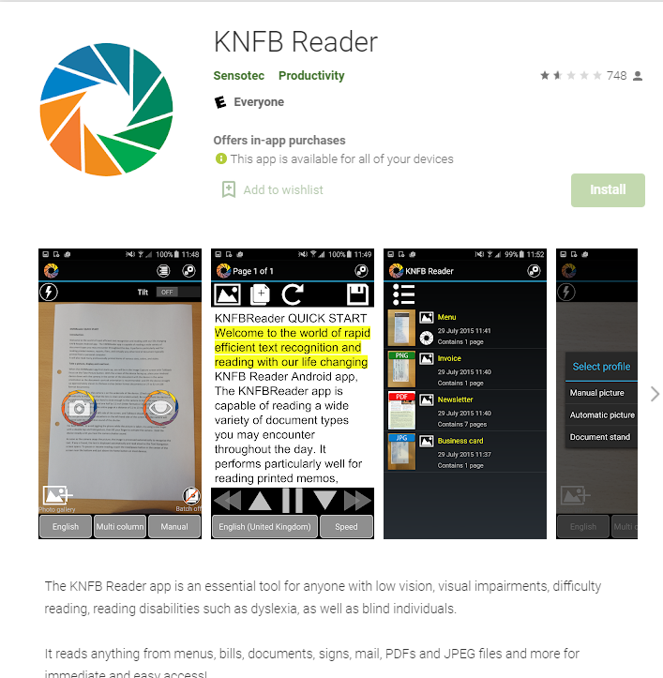
KNFB Reader
Notes:
Ashley: Here’s how the app looks like!

Slide 13
Subtitle Reader
App Description
An app posted on hackaday.io
Uses OCR and a camera on a smartphone or tablet to recognise the text on screen and transforms it into audio
Comparison to our project
Subtitle reader does not read objects in the image taken by the OCR Camera
The blind people would only have access to text captured by the camera
https://hackaday.io/project/21294-subtitle-reader
Notes:
Ashley: The second case study would be subtitle reader, an app posted on hackaday.io. It is similar to the previous one and again it is inferior as it does not have image detection functionality.

Slide 14
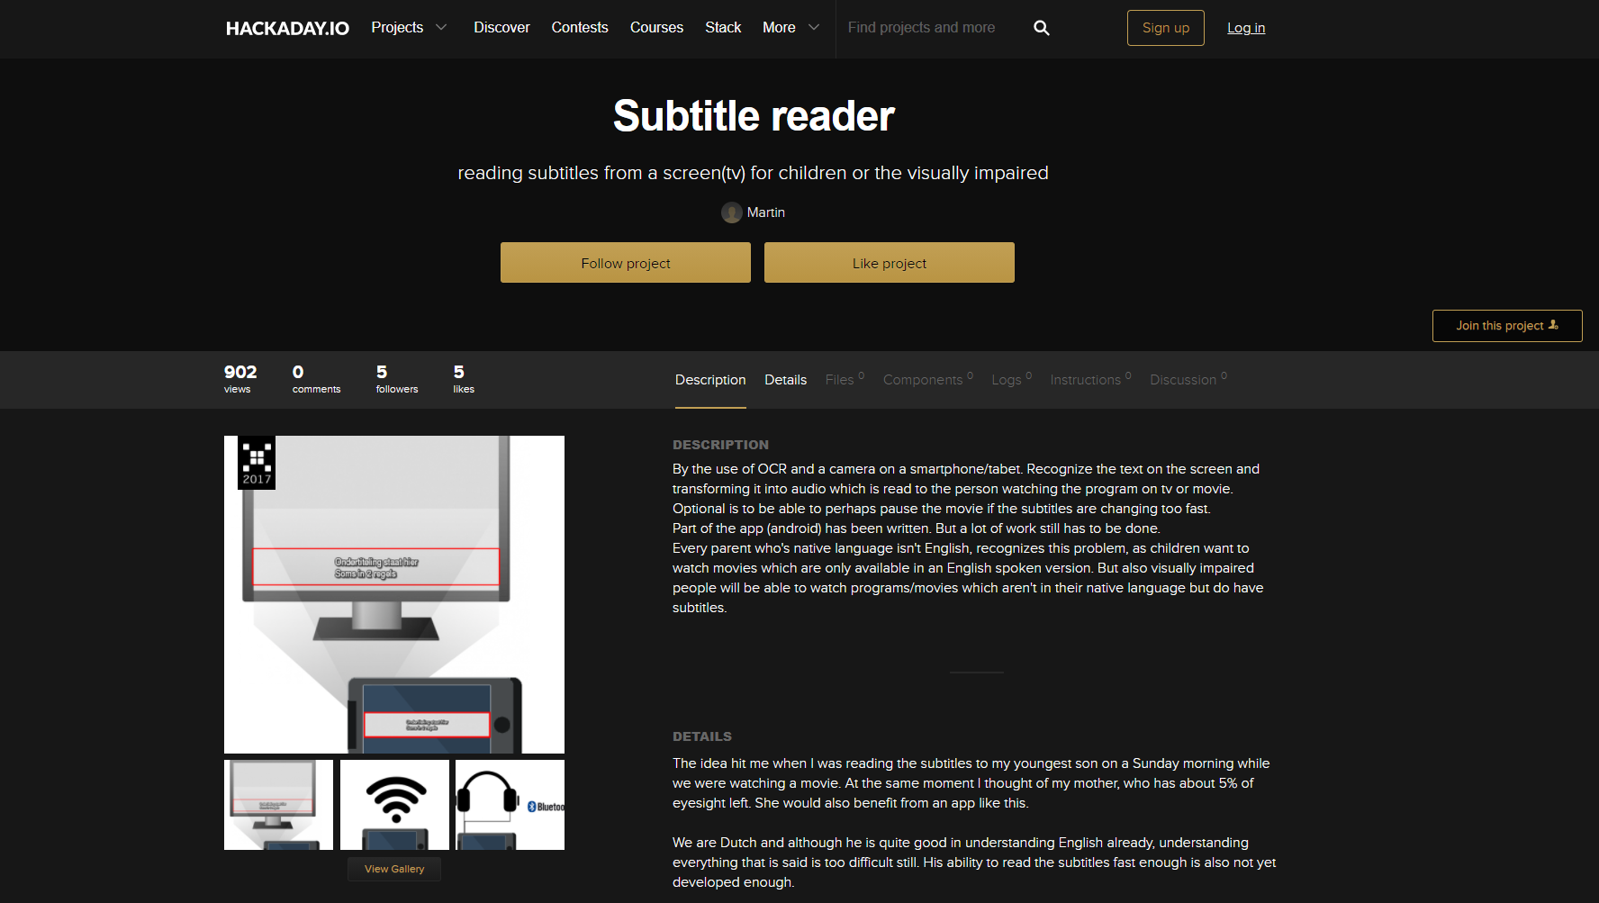
Subtitle Reader
Notes:
Ashley: Here’s how the app looks like!

Slide 15
Deaf-Blind Communication
App Description
A project made in Arduino which aids communication between deaf and blind people
The blind person can hear what is played while the deaf person can see what is shown on the screen
Comparison to our project
Again, this has a limited functionality as it only allows text transmission, and not images
https://create.arduino.cc/projecthub/skyseeker/deaf-blind-communication-with-1sheeld-arduino-bb3362?ref=tag&ref_id=blind&offset=4
Notes:
Ashley: Our last case study is the Deaf Blind Communication Product on the arduino project hub. It allows a blind person to communicate with a deaf person through text to speech. Compared to our project, this also only allows both parties to access only text data, and it would be very sad if they spend their entire lives without any visual description.

Slide 16
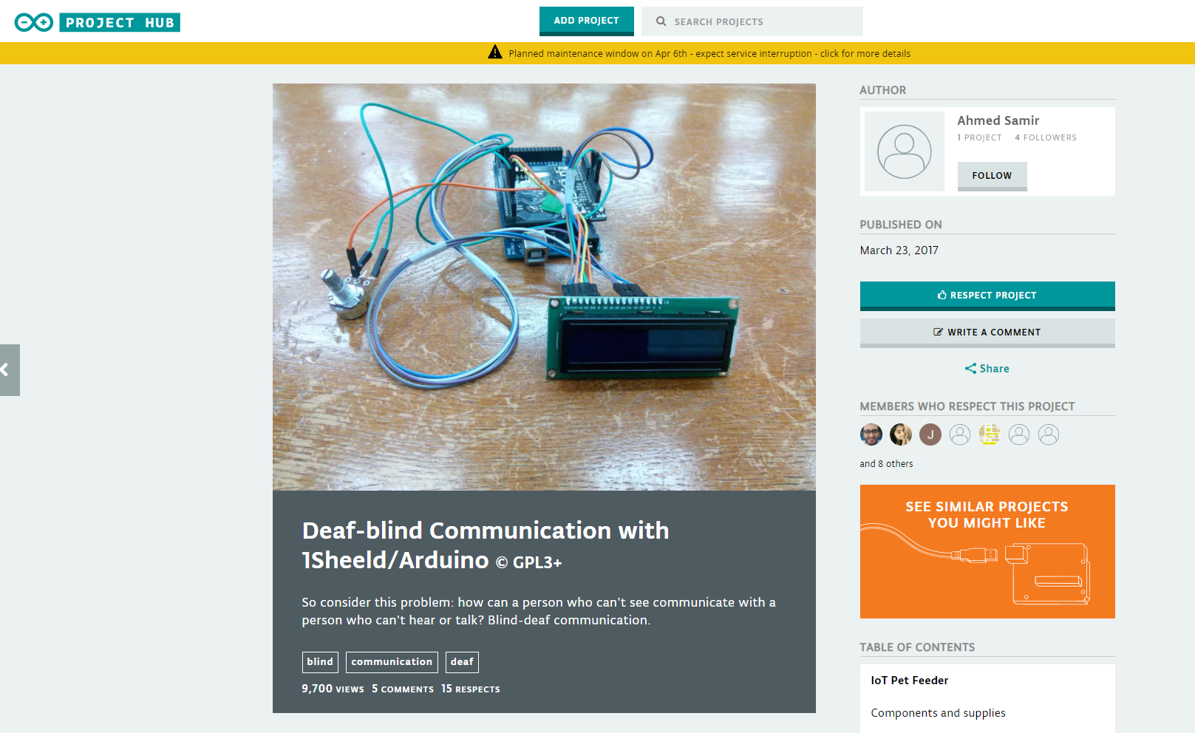
Deaf-Blind Communication
Notes:
Ashley: Here’s how the app looks like!

Slide 17
Area Of Work
Notes:
Tremaine: Now we will move on to our next section, our area of work.

Slide 18
Area of work - Product Description
Scanner
A scanner contains all the functional components
3D Printed Stand
A stand to support the scanner which faces down to look at a piece of paper/book on a flat surface
Notes:
Tremaine: I will start of by describing our product. Our project has 2 modules, first being the scanner, which contains all the functional components, and second being a 3D printed stand that elevates the scanner to face down in order to scan the object on the flat surface.

Slide 19

Area of work - Functionality
A button is pressed
The Camera Module V2.1 captures a picture
The picture is processed by our program in 2 sections
Object Detection - OpenCV (YOLO)
Optical Character Recognition - Tesseract
Notes:
Tremaine: Next, we will introduce the process of the program. Firstly, a button is pressed, triggering the camera to capture a picture, and the program will perform object detection and OCR on the image.

Slide 20

Area of work - Functionality
A sentence is generated to describe the images along with the text in the image
Text is converted to audio file using TTS technology
Lastly, the audio file is read out through the speaker
Notes:
Tremaine: The objects in the image will be described, for example: The image contains a banana, two bottles, and an umbrella. This description is then converted to an audio file read out through a speaker.

Slide 21
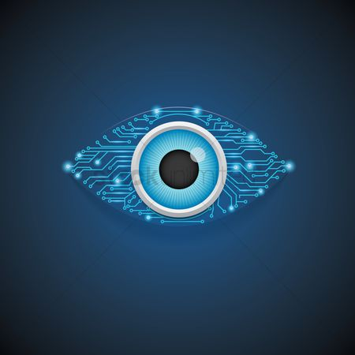
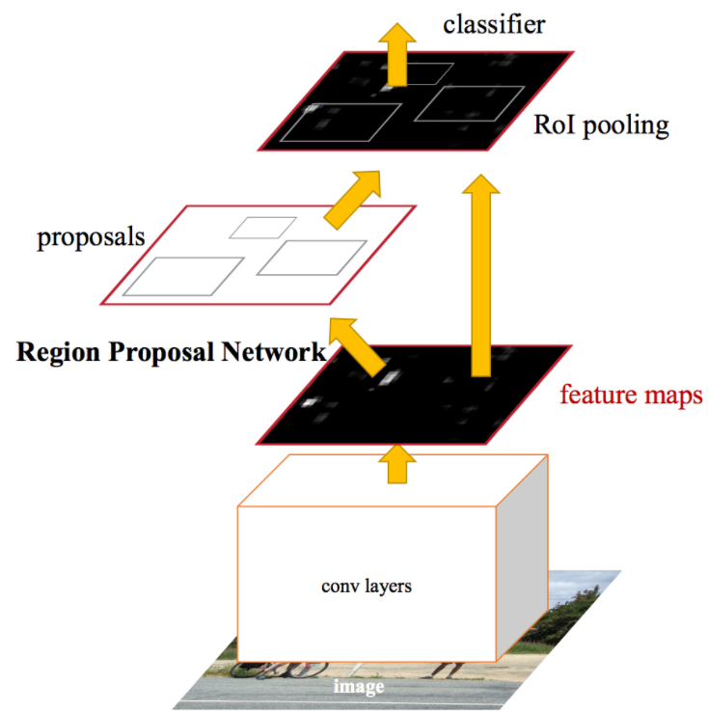
Object Detection Algorithms
YOLO - You Only Look Once
Faster R-CNN
SSD - Single Shot Detectors
Notes:
Tremaine: We did a research write-up on the 3 main families of computer vision algorithms, YOLO, RCNN, and SSD. For the RCNN family, we decided to research only regarding Faster R-CNN for simplicity.

Slide 22

Why we chose YOLO?
YOLO - You Only Look Once
Designed for speed and real-time use
Very suitable for this project as speed is a very important consideration factor
Also excellent at detecting really small objects
Notes:
Tremaine: Eventually, we chose YOLO as it is designed for speed and real-time use, meaning that we can complete the processing of image in milliseconds and it is also great at detecting small objects which is useful for our project

Slide 23

Why not SSD or RCNN?
Faster RCNN
Training data is too long
Training happens in multiple phases
Network is too slow at inference time
SSD - Single Shot Detectors
Has problems detecting small objects
Unsuitable for our project because we require high proficiency in scanning small objects on physical paper
Notes:
Tremaine: The reasons why we did not choose the others included training data being too long, slow detection and problems detecting small objects, which is essential for our project.

Slide 24
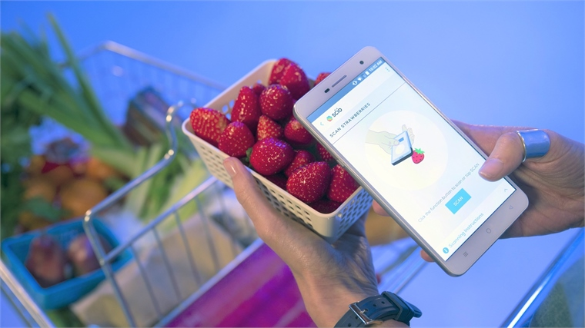
Area of work - Possible Features
For the accessibility of blind people who can use smartphones, a smartphone/tablet app may be developed as another scanner
Notes:
Tremaine: The last section for our area of work will be the possible features. We aim to create a separate app on a smartphone or tablet, which was inspired by the KNFB reader case study as mentioned earlier. Of course, if we were to develop such a product, we would aim to do better than that reader as we want to detect objects rather than just text.

Slide 25
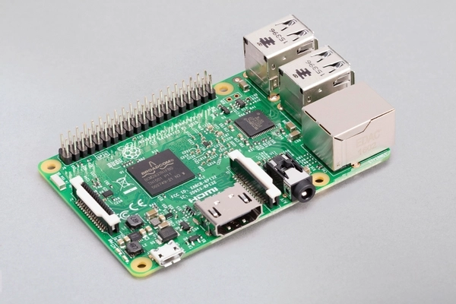
Area of work - Hardware Components
Raspberry Pi Model 3B
Notes:
Tremaine: Next up, we will be listing all the components that we will be using. Firstly, we have the Raspberry Pi Model 3B....

Slide 26
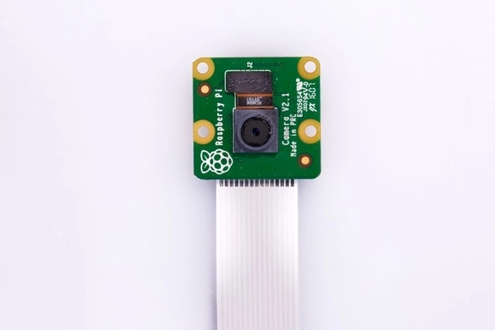
Area of work - Hardware Components
Raspberry Pi Camera Module V2.1
Notes:
the Raspberry Pi Camera Module, ….

Slide 27
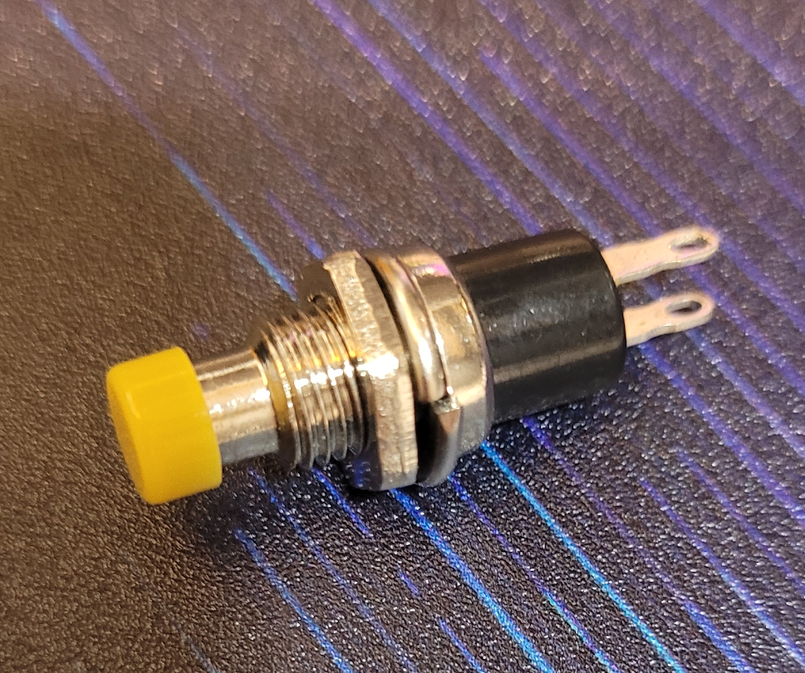
Area of work - Hardware Components
Button
Notes:
A button...

Slide 28
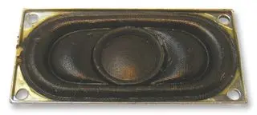
Area of work - Hardware Components
ABS-224-RC Speaker
Notes:
A speaker…

Slide 29
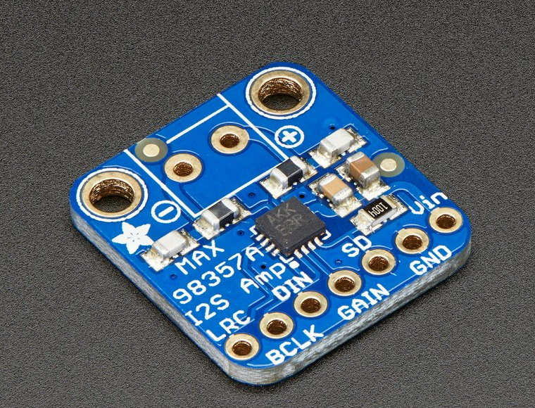
Area of work - Hardware Components
Adafruit I2S 3W Class D Amplifier Breakout MAX98357A
Notes:
An Adafruit Amplifier,

Slide 30
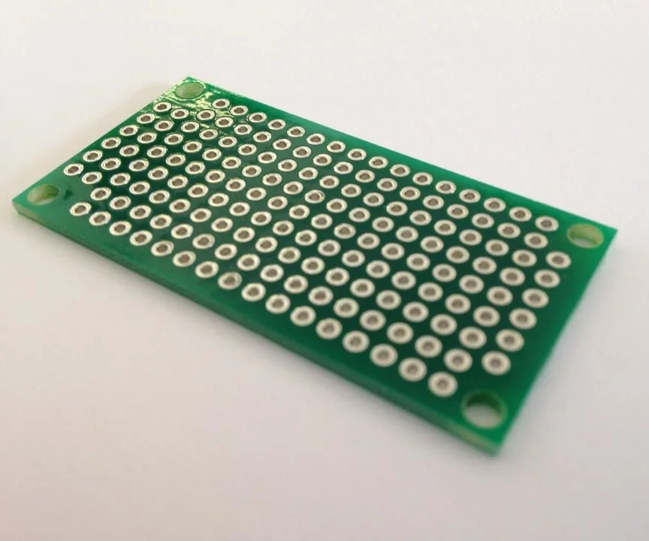
Area of work - Hardware Components
Custom-Made Circuit Board to wire up all the components
Notes:
A custom made circuit board,

Slide 31
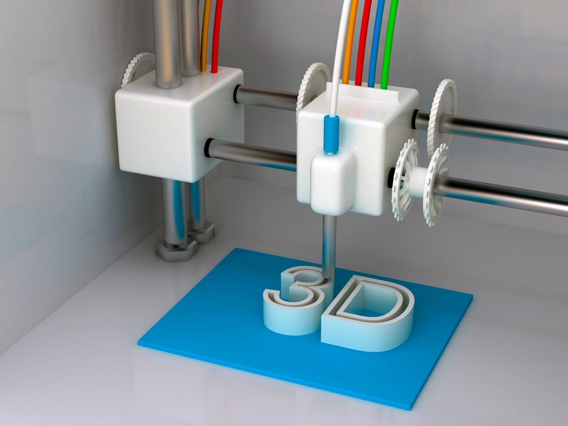
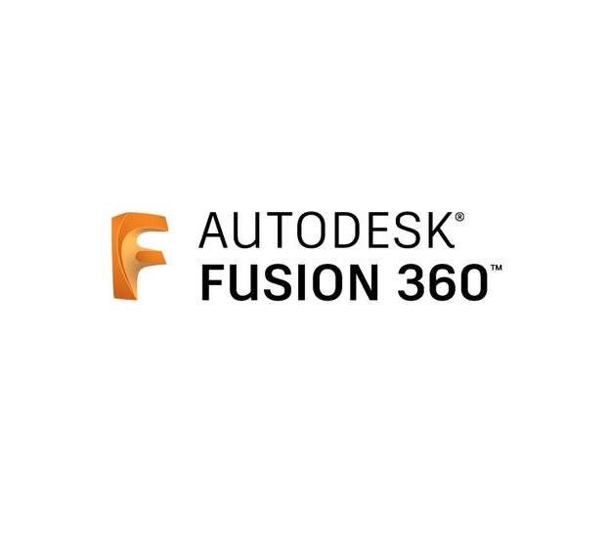
Area of work - Hardware Components
3D Printed Casing for the Scanner and another for the stand
Notes:
, and a 3D Printed Casing and Stand.

Slide 32

Methodology
Collection of data
Reliable sources like CNA and BBC and online research papers
Development tools
Python with many other libraries
pytesseract
opencv
pyttsx3
3D Design tool
Autodesk Fusion 360
Ultimaker Cura
Notes:
Ashley: Moving on to our Methodology, our collection of data will be from reliable sources such as Channels News Asia, BBC, and reliable online research papers. Our development tool for programming will solely be python incorporated with some external libraries such as opencv for object detection, and many others. Our 3D Design tool will only be Autodesk Fusion 360, and Ultimaker Cura for slicing the 3D Models.

Slide 33

Background Knowledge
Tan Kwang Yik Tremaine
Decent knowledge of Python
No experience with Raspberry Pi
No experience with 3D Modelling in Autodesk Fusion 360, though some experience with blender
Khng Ashley
Decent knowledge of Python
No experience with Raspberry Pi and 3D Modelling
Notes:
Ashley: This is our background knowledge at the time that we started this project. Both of us do not have much experience in some areas that we will be relying a lot on but we will be learning more about these through online tutorials and research.

Slide 34
Job Distribution
Notes:
Ashley: Moving on to our job distribution, …...

Slide 35
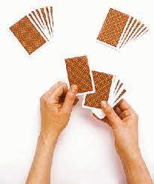
Job Distribution
Code is generally modular based
Main Skeleton
The main program that is running
Imports various modules
Modules are written by respective group members responsible for whichever module
Notes:
Ashley: ……. One of the great aspects of our project is the teamwork. We have a modular based code, allowing every group member to write code for different modules that they are responsible for. A main skeleton program will then import the modules and run the main program.

Slide 36

Job Distribution - Software Side
Khng Ashley
Camera functionality
Optical Character Recognition (OCR)
Object Detection (Researched and Done Together)
Tan Kwang Yik Tremaine
Main skeleton
Text-to-speech
Object detection (Researched and Done Together)
Code cleanup
GitHub for collaboration
Notes:
Ashley: To break down our software components, I will write the camera and OCR modules, and Tremaine will write the TTS module, main skeleton, and do code cleanup. The Object Detection module will be done together. We will also be using Github for code collaboration

Slide 37

Job Distribution - Hardware Side
Khng Ashley
3D design of stand to hold the scanner
Tan Kwang Yik Tremaine
3D design of the scanner - Both Casing and Lid
Wiring and Soldering of circuit
Notes:
Ashley: To break down our hardware components, I will design the stand for the project and Tremaine will design the scanner and make the circuit board.

Slide 38
Timeline

Slide 39





Timeline
April
Research and do the necessary write-ups on libraries used
Complete Proposal Evaluation Slides
May
Use Judges’ Comments to complete prototype by the end of May
July
June
Improve Prototype using Judges’ Comments and work on possible features
Beta testing of prototype and obtain user feedback
Complete Written Report and 50% of Final Evaluation Slides
Start working on possible features if time permits
Start working on Mid-Term Evaluation Slides
Start working on Written Report
August
Aim to finish possible features if possible
Complete Final Evaluation Slides
Notes:
Ashley: Here’s our timeline

Slide 40
Conclusion
Our project aims to aid the visually impaired people by allowing them to read easily. With this project in place, the visually impaired would be able to read more easily and hopefully the literacy rates of blind people would be increased.
Notes:
Tremaine: Finally, we can conclude that our project aims to aid the visually impaired people by allowing them to read easily. With this project in place, the visually impaired would be able to read books more easily and hopefully the literacy rates of blind people would be increased.

Slide 41
Bibliography
The Braille Literacy Crisis in America. (2009). Retrieved 25 January 2021, from https://www.nfb.org//images/nfb/documents/pdf/braille_literacy_report_web.pdf
Braille Literacy Statistics and How They Relate to Equality. (2016). Retrieved 25 January 2021, from https://brailleworks.com/braille-literacy-statistics/
McDonnall, M., & Cmar, J. L. (2019, October 14). Blind people have increased opportunities, but employers’ perceptions are still a barrier. The Conversation. Retrieved 25 January 2021, from https://theconversation.com/blind-people-have-increased-opportunities-but-employers-perceptions-are-still-a-barrier-124977
Notes:
Tremaine: Here are our References.

Slide 42
THANK YOU
Notes:
We have come to the end of our presentation. Thank you!

Slide 43
Q & A

